Slide 1

SMART CITY
“A Developed City ”
Presented By :
Sagar F.Honnabindagi
Hemanth
Ijaz
2022

Slide 2
Content
Introduction
Examples
Problems
Solutions
Product Overview
Market and Competition
Business Model
2022

Slide 3
Table of contents
01
02
03
04
Problem vs solution
Product overview
Market & competition
Business model
2022

Slide 4
Introduction
A smart city is a technologically modern urban area that uses different types of electronic methods and sensors to collect specific data.
Information gained from that data is used to manage assets, resources and services efficiently; in return, that data is used to improve operations across the city.
2022

Slide 5
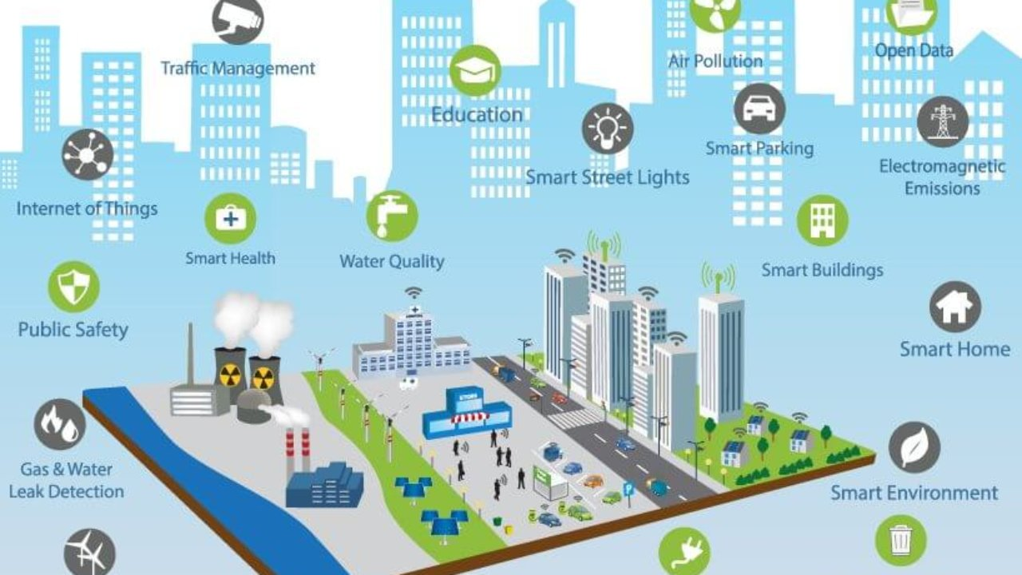
Types of Smart Concepts
2022

Slide 6

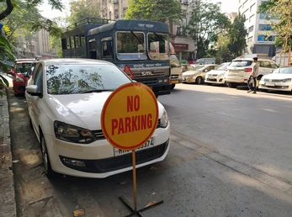
Problem - 1
01
Parking in Unauthorized Area or in No Parking Area
2022

Slide 7
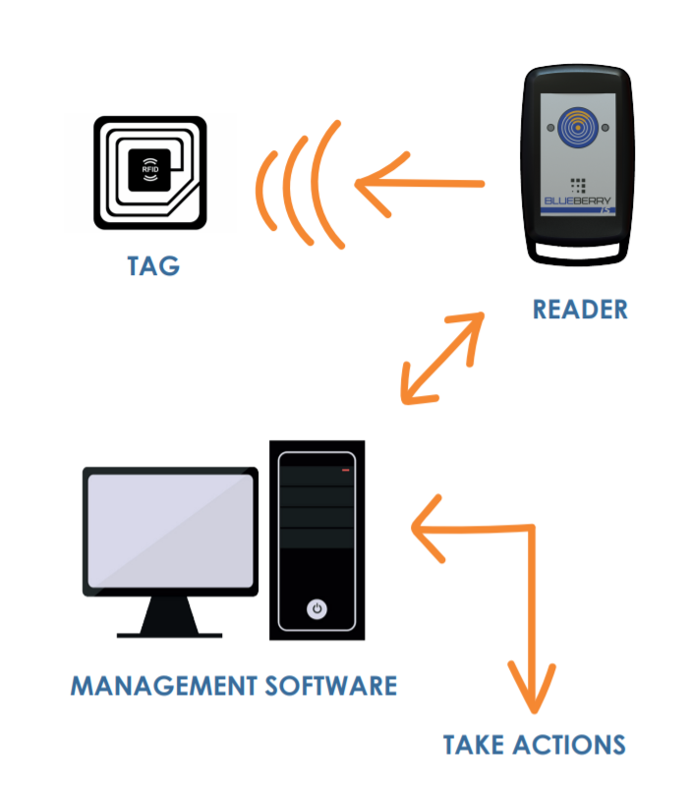
Solution
A fully automated fine paying system using Cameras and RFID reader can be implemented
2022

Slide 8
Product overview
The purpose of product solves major un-necessary parking that happens on daily bases.
The use of this feature reduces the human work by automating the work.
Energy : The energy source can be taken from solar panels implemented with the model.
The market positioning is very high on Government Sector, Hospitals.
2022

Slide 9
Market & Competition
Finance : The implementation of this idea may cost upto 20k – 30k per parking lot.
The market competition for this product maybe 0% to none and can make huge market value.
This idea can be used in Research and Development in government sector that intern profits the government.
2022

Slide 10
Business model
The monthly fee for maintenance of Cameras and RFID tags in parking can be charged.
Finance : The maintenance of server can be charged to maintain previous data for 15k – 20k.
The cameras in parking provide extra security to the owners.
2022

Slide 11
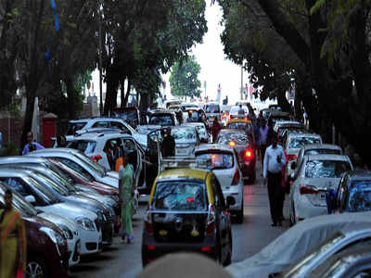
02
Problem - 2
Topic : Parking facilities.
Lack of parking vehicles in the cities

Slide 12
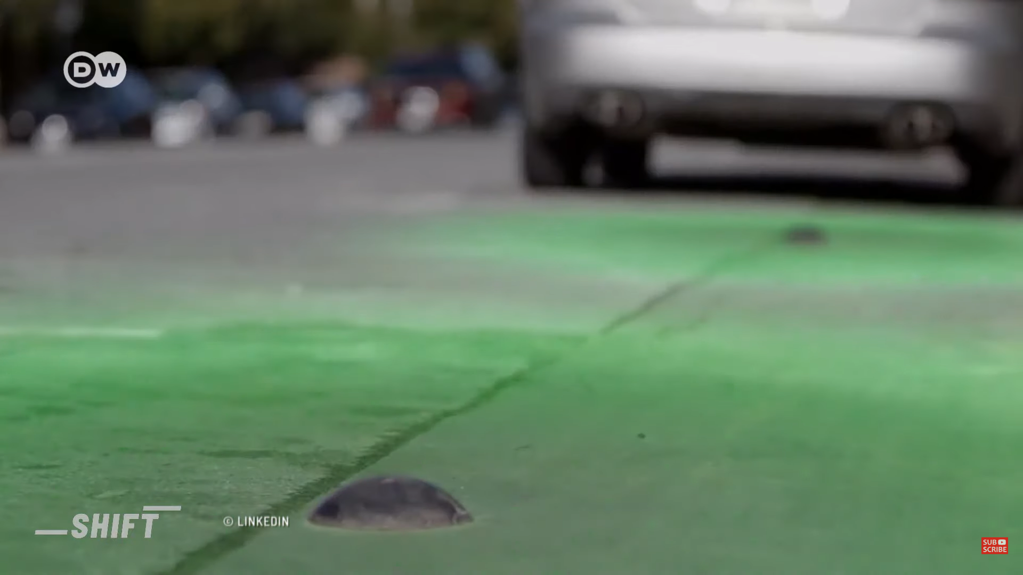
Solution
Building up the sensors and installing it on the parking areas.
Developing an application
2022

Slide 13
Product overview
We can implement the sensors on the roads where vehicles can be parked.
An application can be developed so the users can see whether parking options are available near there location through the sensors in a proper way the vehicles can be parked
Energy : The energy source can be used with solar panels.

Slide 14
Market & Competition
Finance : The implantation of this idea may cost to an estimate of 50k – 60k.
This idea can be used in Research and Development in government sector that intern profits to the public users.
14
2022

Slide 15
Business model
The maintenance of server can be charged to maintain ongoing data.
The application usage and the sensors can be charged through the road taxes.
2022

Slide 16
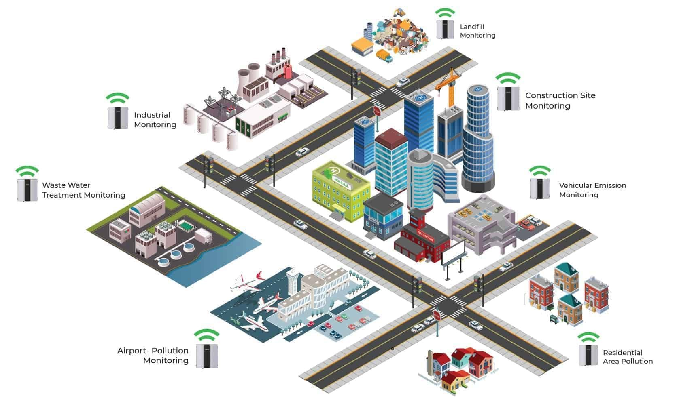
Air pollution in smart cities
03
Problem -3
2022

Slide 17
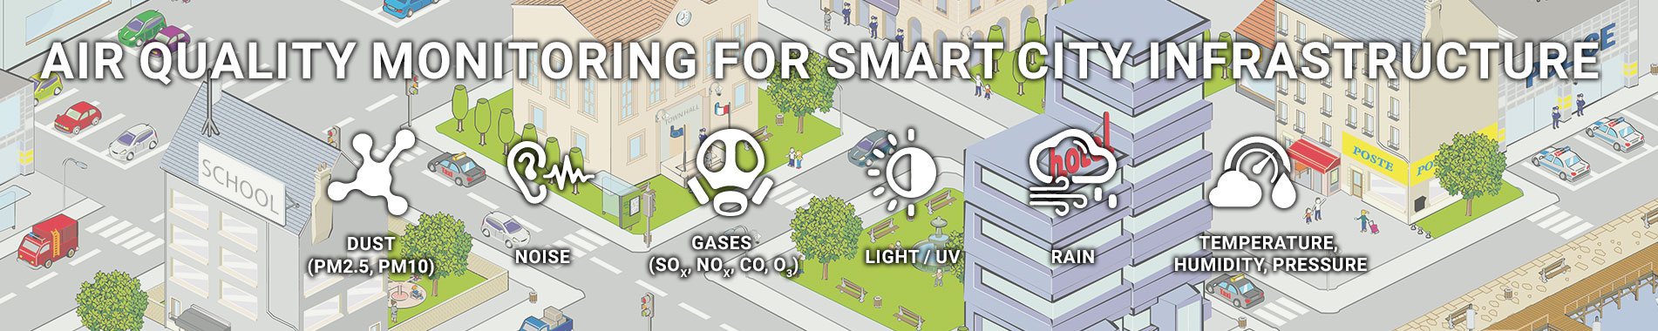
Why air monitoring system is required?
For Smart cities, it is necessary to monitor the environmental conditions for identifying the sources of pollution and mitigate them. So, a network of low-cost air quality monitoring sensor nodes can be deployed to monitor air quality and meteorological parameters. Hence, through pollution source detection, the city can take corrective measures and improve its environmental health.
2022

Slide 18
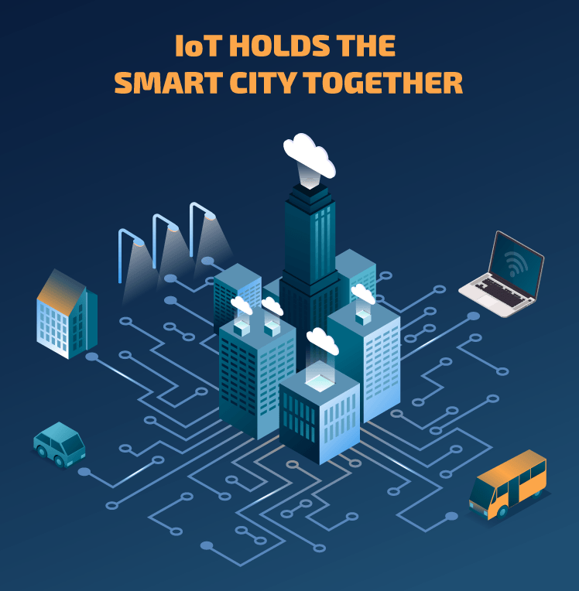
Solution
AIR MONITIORING SYSTEM
Urban air pollution from combustion products and volatile organic compounds poses serious health risks. As a result, major cities are taking a proactive approach by creating spatially dense air-quality-monitoring networks. These integrated IoT sensors can identify polluters and help implement smarter, healthier public transportation and urban planning solutions.
2022

Slide 19
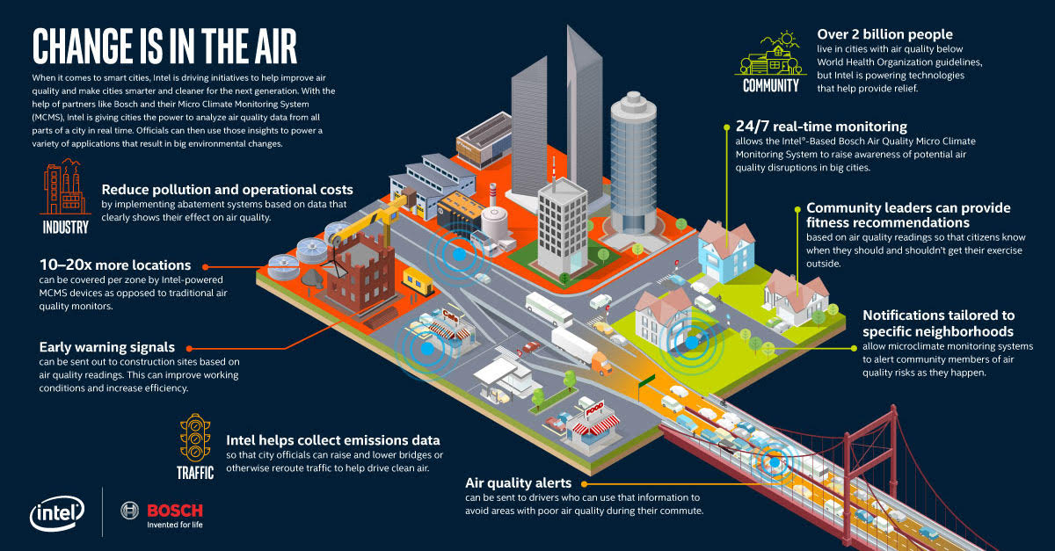

Slide 20
Benefits of air quality monitoring system
Human Health
Whether closed or open premises, human health gets affected by the increase in air pollutants or particulate matter. Thus, installing an air quality monitoring system helps monitor the presence of pollutants, resulting in better environmental conditions for humans to reside. This also impacts their health and reduces the chances of occurring any health issues by maintaining a moderate ambiance or as required.
Hence, IoT-powered solutions provide better services to the industrialists, which in turn, provides better services to their customers. It creates a positive impact on human health by eliminating unwanted air pollutants and particulate matter by allowing the authorities to take decisions according to the situation.
2022

Slide 21
Market & Competition
Energy : Eco Friendly Batteries and a backup of solar energy.
Finance : The implantation of this idea may cost to an estimate of 30k – 40k.
The idea can be used in cities by developing iot sensors, iot devices, cloud computing etc. which also makes a big competition in business market
2022

Slide 22

YOUR WORLD,SMARTER

